Slide 1




Apps for Edu

Slide 2
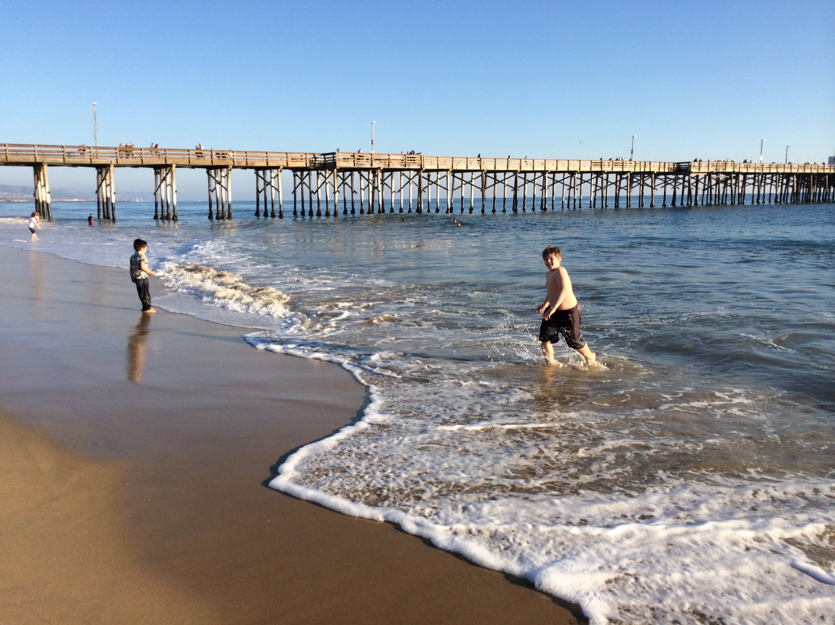

Slide 3


Slide 4
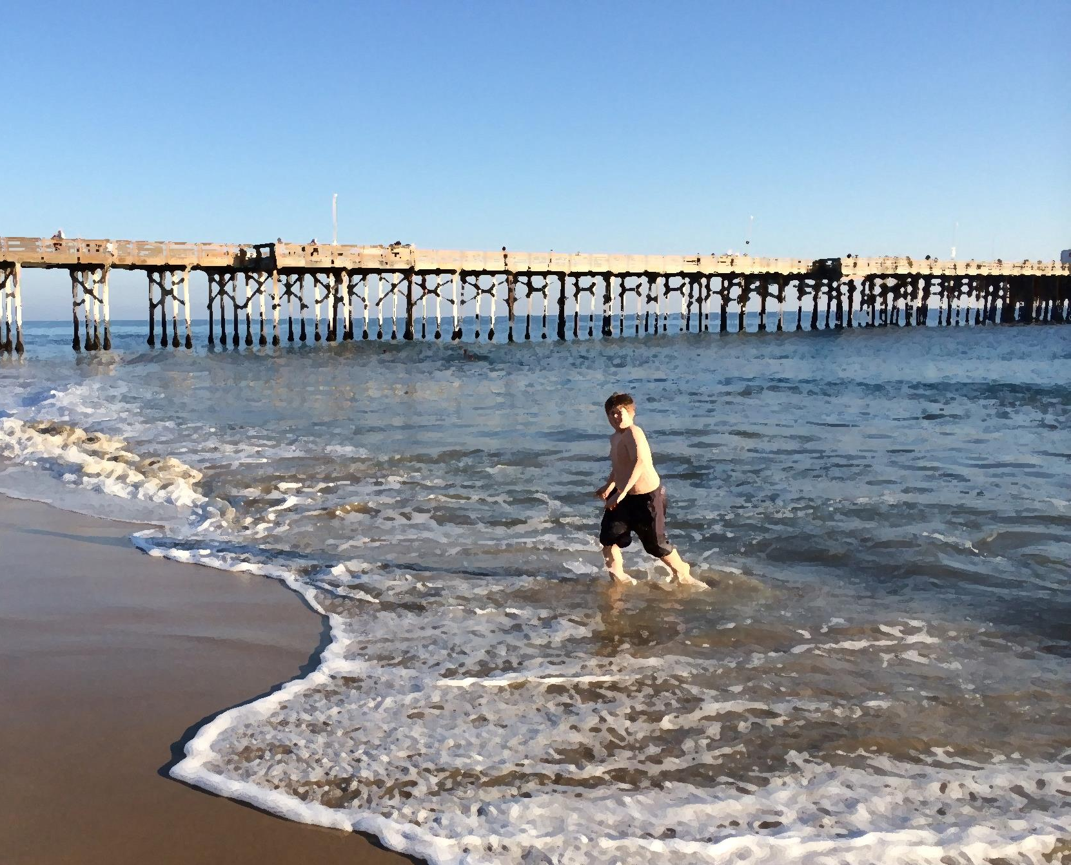


California

Slide 5

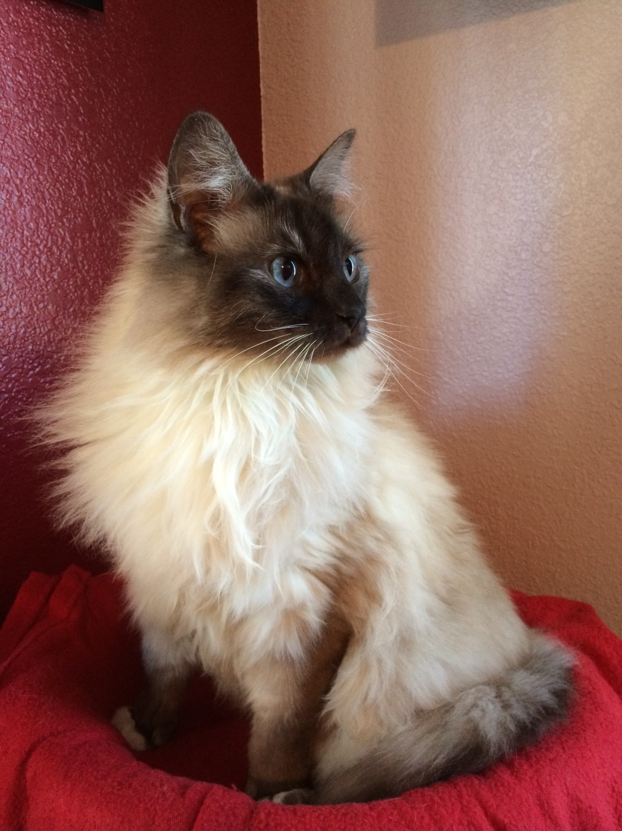
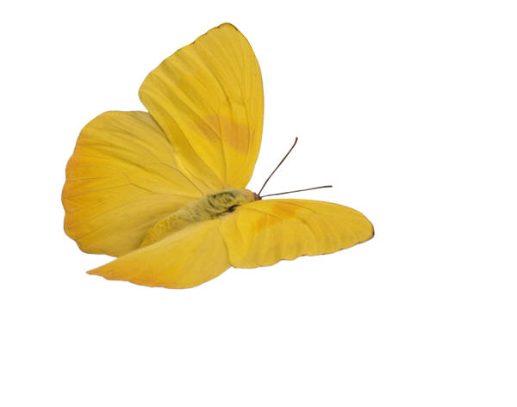

Slide 6


Slide 7
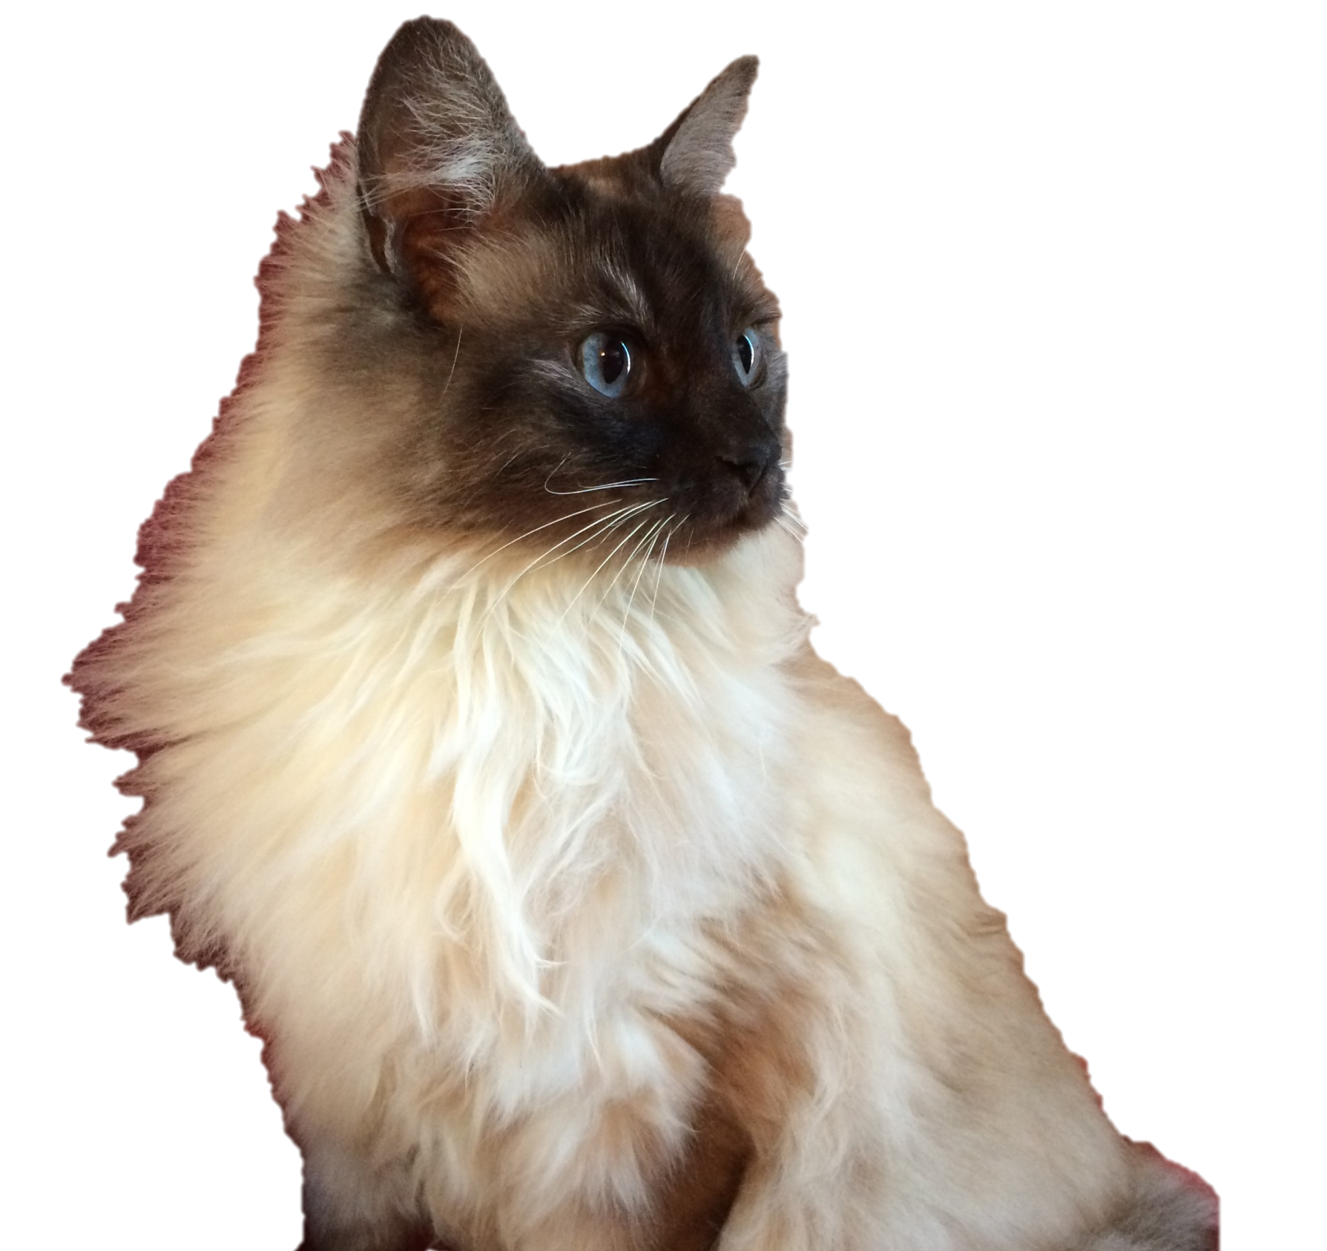


“Quote about spring and how Naudia wants to kill that butterfly”
Deep thought by Tina

